Slide 1
My Family
By Claudia Duque

Slide 2
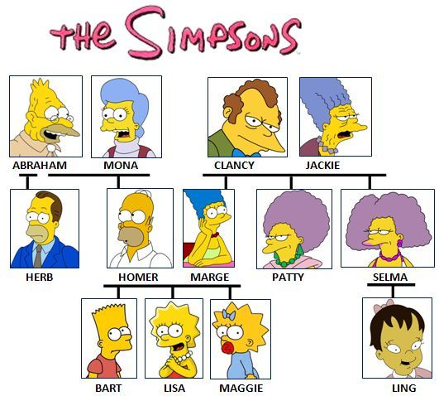
Family tree

Slide 3
History of a Family
born
baptize
grow up
go to school
move
die

Slide 4


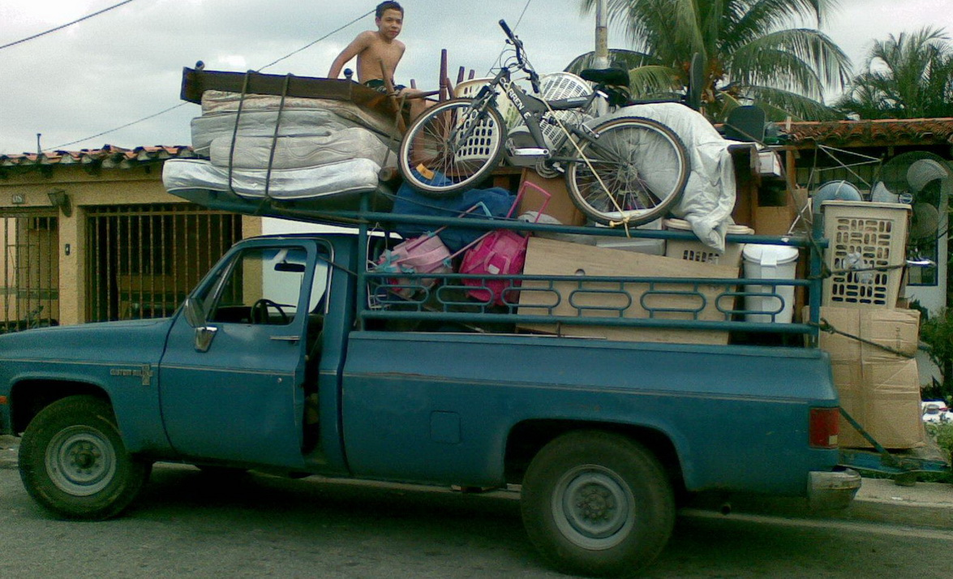
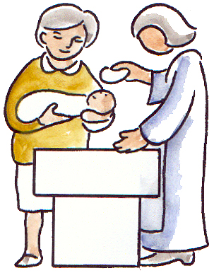
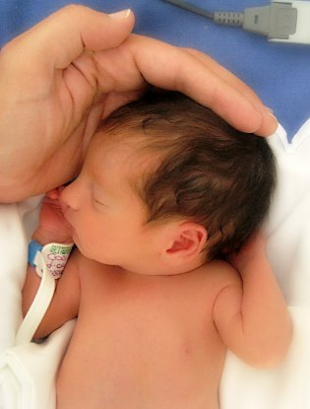

History of a Family

Slide 5
History of a Family
Fall in love
be engaged
marry , get married
be pregnant
expect a baby
give birth to

Slide 6
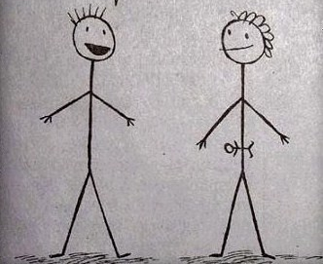
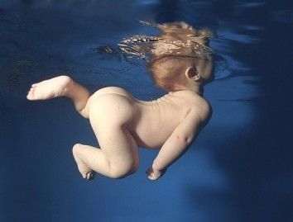
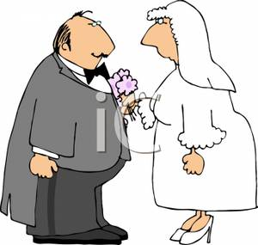

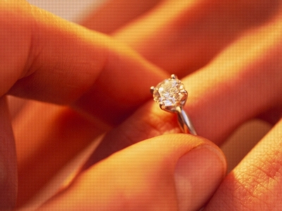
History of a Family

Slide 7
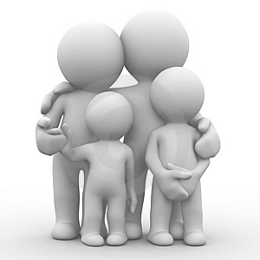
Parents and children

Slide 8
To have
(affirmative) (negative)
I have…
You have…
He has…
She has…
It has…
We have…
You have…
They have…
I don’t have…
You don’t have…
He doesn’t have…
She doesn’t have …
It doesn’t have …
We don’t have…
You don’t have…
They don’t have…

Slide 9

I love my parents.
Father, dad, daddy
Mother, mom, mummy

Slide 10
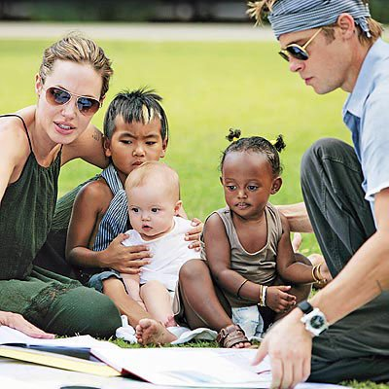
Stepparents

Slide 11


stepbrother
stepsister
half sister
half brother

Slide 12
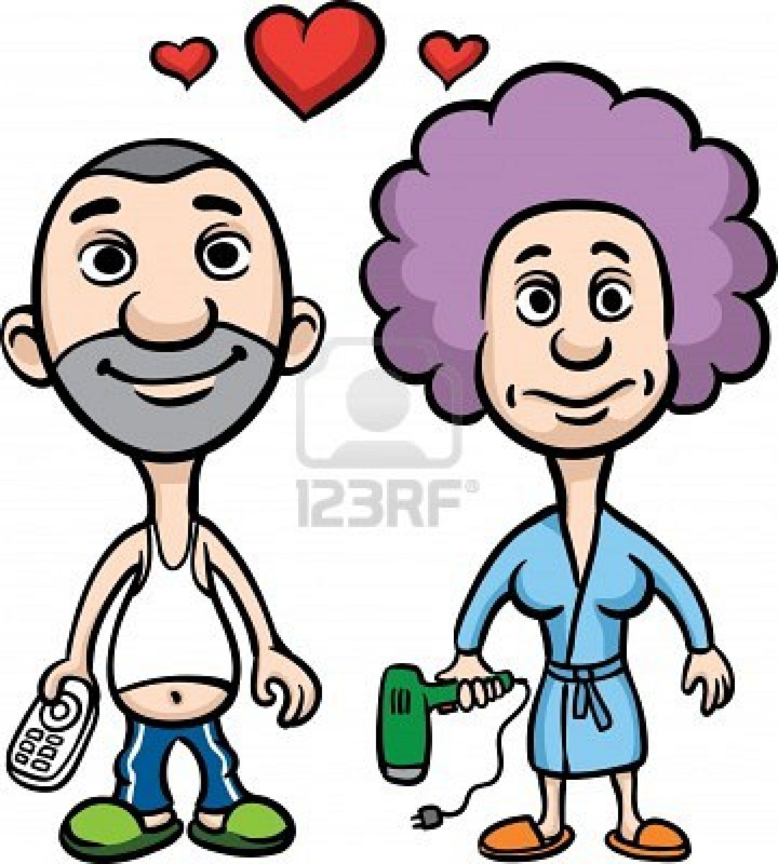
Spouse
(male and female)
husband and wife

Slide 13

Children
daughter
son

Slide 14
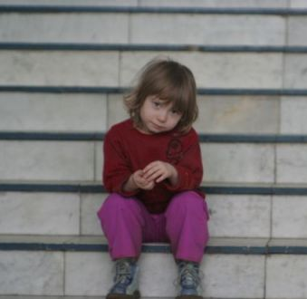
Are you the only child (son or daughter?

Slide 15
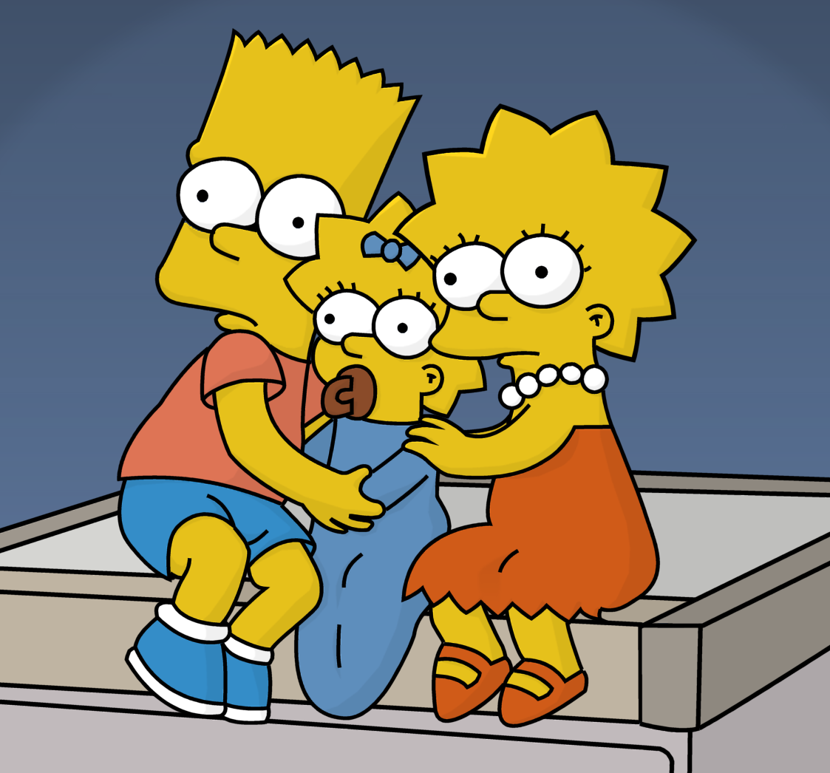
siblings
brother
sister

Slide 16
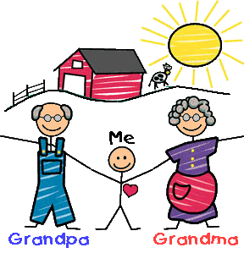
Grandparents
grandfather
grandmother

Slide 17
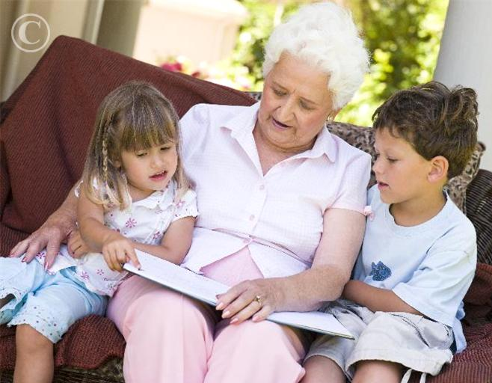
grandchildren
grandson
granddaughter

Slide 18
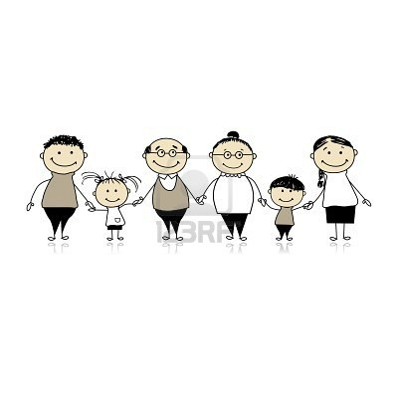
Members of the Family
uncle
aunt
niece
nephew

Slide 19
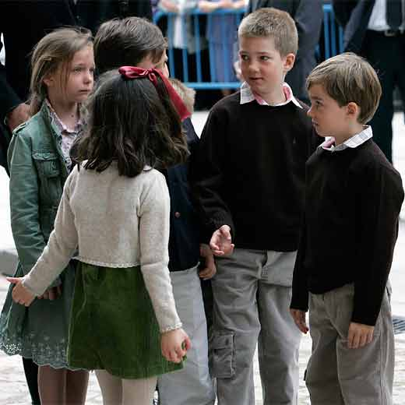
cousins
cousin
cousin

Slide 20
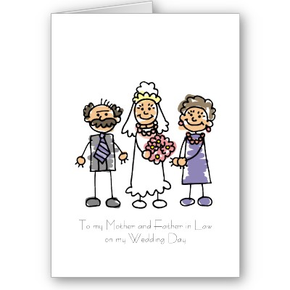
parents-in-law
father-in-law
mother-in-law

Slide 21
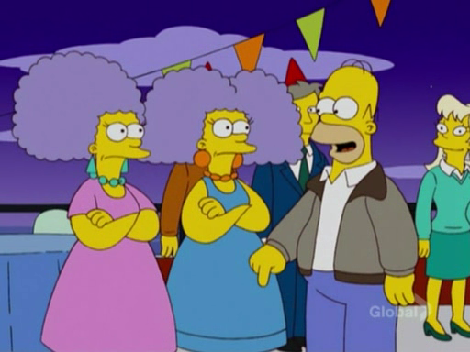
brothers-in-law
brother-in-law
sister-in-law

Slide 22
Quiz
My father’s mother is my…
My mother’s father is my…
My father’s daughter is my…
My mother’s son is my…
My mother is my father’s …

Slide 23
answers
grandmother.
grandfather.
sister.
brother.
wife.

Slide 24
Quiz
My grandfather is my grandmother’s …
My brother is my father’s …
My sister is my mother’s…
My father’s sister is my…
My mother’s brother is my…

Slide 25
answers
husband.
son.
daughter.
aunt.
uncle.

Slide 26
Quiz
My uncle’s daughter is my…
My daughter is my mother’s…
My brother is my grandfather’s…
My sister’s husband is my…
My husband’s sister is my …

Slide 27
answers
cousin.
granddaughter.
grandson.
brother-in-law.
sister-in-law.

Slide 28
Quiz
My aunt’s daughter is my mother …
My uncle’s son is my father’s…
My father’s new wife (not my mother) is my …
My father and my stepmother’s daughter is my …
My stepmother’s son (not my father’s son) is my

Slide 29
answers
niece.
nephew.
step mother.
half-sister.
step brother.

Slide 30
How was your childhood?
What is your full name? Why did your parents select this name for you? Did you have a nickname?
Where were you born?
How did your family come to live there?
What was the house (apartment, farm, etc.) like? How many rooms? Bathrooms?
Did you have any pets? If so, what kind and what were their names?

Slide 31
How was your childhood?
Were there any special items in the house that you remember?
What is your earliest childhood memory?
Describe the personalities of your family members.
What kind of games did you play growing up?
What was your favorite toy and why?

Slide 32
How was your childhood?
Did you have family chores? What were they? Which was your least favorite?
Did you receive an allowance? How much? Did you save your money or spend it?
What was school like for you as a child? What were your best and worst subjects?
Who were your childhood heroes?
What were your favorite songs and music?

Slide 33
My childhood
How is the world today different from what it was like when you were a child?
Who was the oldest relative you remember as a child? What do you remember about them?
Of all the things you learned from your parents, which do you feel was the most valuable?
What accomplishments were you the most proud of?
www.about.com

Slide 34
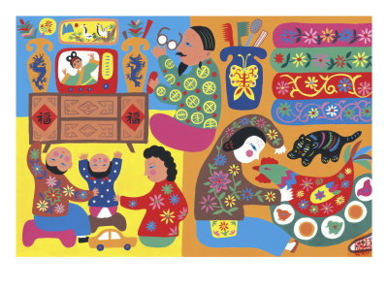
“I don't care how poor a man is; if he has family, he's rich.”
Dan Wilcox and Thad Mumford

